Slide 1


Green Pace
Security Policy Presentation
Developer: Giovanni Oddo
Link: https://youtu.be/zwsbhNv09nc

Slide 2

OVERVIEW: DEFENSE IN DEPTH
This secure coding policy covers principles and coding standards that use defense-in-depth approach. This ensures that applications shipped by Green Pace are safe to use while maximizing automation, lowering costs, and preventing architectural vulnerabilities through DevSecOps practices.

Slide 3
THREATS MATRIX
The threat matrix helps with assessing the threat level of each security risk by how likely they are to occur and the priority level to fix when an attack is active or successful.
Likely STD-002-CPL STD-003-CPP STD-004-CPL STD-005-CPP STD-007-CPP STD-008-CPP STD-009-CPP STD-010-CPP | Priority STD-001-CPP - MEDIUM STD-002-CPL - MEDIUM STD-003-CPP - HIGH STD-004-CPL - HIGH STD-005-CPP - HIGH STD-008-CPP - HGIH STD-009-CPP - HIGH
Low priority STD-006-CPL - LOW STD-007-CPL - LOW STD-010-CPP - HIGH | Unlikely STD-001-CPP STD-006-CPP

Slide 4
10 PRINCIPLES
1. Validate Input Data
STD-002 –CPL
STD-003-CPP
STD-004 –CPL
STD-009-CPL
2. Heed Compiler Warnings
STD-001-CPL
STD-002 -CPL
3. Architect and Design for Security Policies
STD-006-CPP
STD-007 –CPP
STD-010 -CPP
4. Keep It Simple
STD-003-CPP
STD-004 –CPL
STD-006-CPP
STD-010 -CPP
5. Default Deny
STD-008 -CPP
6. Adhere to the Principle of Least Privilege
7. Sanitize Data Sent to Other Systems
STD-004 -CPL
8. Practice Defense in Depth
STD-006-CPP
STD-007 –CPP
STD-010 -CPP
9. Use Effective Quality Assurance Techniques
STD-005 –CPP
STD-009-CPL
10. Adopt a Secure Coding Standard
STD-001-CPL
STD-002 –CPL
STD-005 –CPP
STD-008 -CPP

Slide 5
CODING STANDARDS By order of priority
Sanitize data passed to complex subsystems
Do not attempt to create a std::string from a null pointer
Detect and handle memory allocation errors
Properly deallocate dynamically allocated resources
Do not dereference null pointers
Ensure that integer conversions do not result in lost or misinterpreted data
Ensure that unsigned integer operations do not wrap
Handle all exceptions
Do not abruptly terminate the program
Understand the termination behavior of assert() and abort()
Notes:
Ordered by priority first, then severity, and remediation cost

Slide 6
ENCRYPTION POLICIES
Encryption at rest
This type secures data while it is stored which could be locally on a client or in a database. By using encryption tools to scramble sensitive data written into those files into an unreadable state, this can prevent a data breach in the event of a security breach.
Encryption in flight
This type refers to protecting data when it is being transferred over the internet. Using protocols such as HTTPS, TLS/SSL, and SNI coupled with encryption, data such as emails, files, and payment transactions can be securely transferred over the internet to verified recipients that hold the correct key to decrypt the data.
Encryption in use
This type refers to data being accessed by users and actively being used. This is used by coupling security measures such as encryption, user authentication, and establishing permissions for who can perform actions on the data. This is to ensure that unauthorized users cannot change or store sensitive data.
Notes:
[Explain the policies for encryption in flight, at rest, and in use.]

Slide 7
TRIPLE-A POLICIES
Authentication
This first step verifies who the user is when logging into a system and recognizes if they are allowed to access the system. Verification can be achieved using a secure password, single sign-on, biometrics, digital certificates, or PKI tokens coupled with a password. This step controls who is allowed to access the system. This step is also used to add new users to the system.
Authorization
This defines the permissions and privileges allowed by the system to the user. Using controls such as Role Based Access Control or Attribute Based Access Control, allows authorized users to perform tasks at the appropriate level. This safeguards sensitive data from being access, manipulated, or stored by unauthorized users.
Accounting
This step records pertinent audit data as users interacts with a system. Data such as sessions statistics, data usage, and commands issued are logged and reviewed by personnel. This step ensure that users are working in compliance within their scope of responsibilities and hold those accountable if attempting to access restricted data.
Notes:
[Explain the policies that support authentication, authorization, and accounting.]

Slide 8
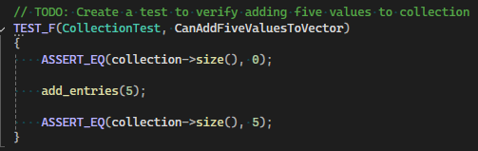
Unit Testing CanAddFiveValuesToVector
Notes:
[Identify the coding vulnerability you chose to test. Include four to six mixed tests for positive and negative results. Include a slide for each test. Use the question for the test as the title. Show the results.]

Slide 9
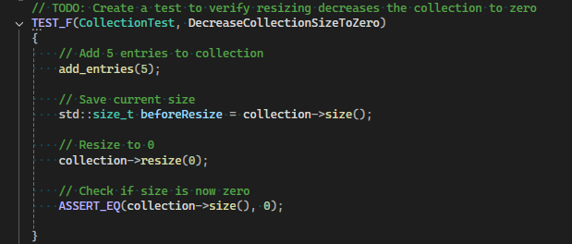
Unit Testing CanDecreaseCollectionSizeToZero
Notes:
[Identify the coding vulnerability you chose to test. Include four to six mixed tests for positive and negative results. Include a slide for each test. Use the question for the test as the title. Show the results.]

Slide 10
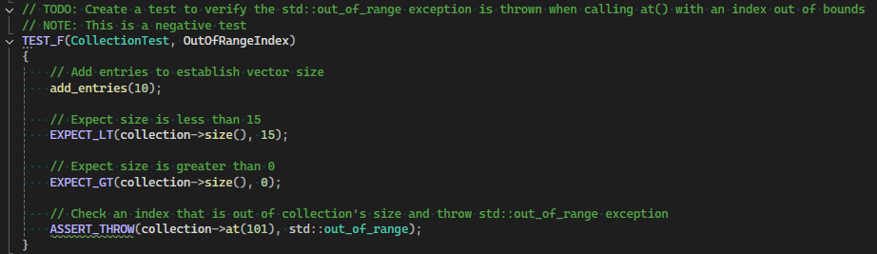
Unit Testing IsOutOfRangeIndex
Notes:
[Identify the coding vulnerability you chose to test. Include four to six mixed tests for positive and negative results. Include a slide for each test. Use the question for the test as the title. Show the results.]

Slide 11
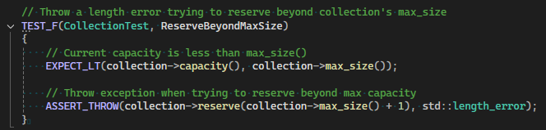
Unit Testing IsReserveBeyondMaxSize
Notes:
[Identify the coding vulnerability you chose to test. Include four to six mixed tests for positive and negative results. Include a slide for each test. Use the question for the test as the title. Show the results.]

Slide 12

AUTOMATION SUMMARY
The DevSecOps pipeline integrates security practices at each stage of the software development lifecycle to maximize software security and data integrity. This approach to development allows security to be a focal point of discussion and integration as a project progresses with the end goal of mitigating as many vulnerabilities as possible by deployment.

Slide 13
TOOLS
Asses and Plan – OWASP and Threat Modeler can identify early threats and provide solutions for mitigation.
Design – Google Test and OWASP Top 10 can be used to create scaffolding for tests specifying methods to be used in production.
Build – CMake and Clang can provide trusted repositories and architecture for secure coding.
Verify and Test – Parasoft C++ Test and CodeSonar tools can be used to automate unit and static testing.
Transition and Health Check – Docker can be used for penetration testing in a secure container to check for any other vulnerabilities before deployment
Monitor and Detect – Tools such as Splunk and SIEM monitor for abnormal activities and log all activity to trace where a vulnerability may be.
Respond – Custom scripts can be used to stock turn services off during an attack
Maintain and Stabilize – constantly test and update after an incident to ensure system stability
Notes:
[Explain the DevSecOps pipeline.]
[Summarize the external tools and where and how they are used in the context of the diagram.]

Slide 14
RISKS AND BENEFITS
Prevention
RISKS
Upfront costs (training, tools and time spend on design)
Longer time spent in design phase
Security impedes progress
BENEFITS
Fewer vulnerabilities
Lower remediation cost
Instill security mindset
Reaction
RISKS
Increased remediation costs
Delayed product release
Higher number of vulnerabilities
Longer time spent in testing
BENEFITS
Faster development
Notes:
[Describe the problems, the solutions, and the risks or benefits involved if you act now or wait. Where is the strategy lacking? What are the risks of using this strategy? Which steps should be taken?]

Slide 15
RECOMMENDATIONS
Gaps in security policy
Add standards for threat modeling in the assess and plan phase
Specify which events to be logged and add specific tools to be used
Develop security training schedule for developers
Add platform specific standards.
Notes:
[Identify gaps in the security policy.]

Slide 16
CONCLUSIONS
Initial and Annual refresher for security training using OWASP Top 10 vulnerabilities and project specific vulnerabilities.
Log all pertinent events to catch active attacks or outlier behavior
Highlight key practices with cloud, web, and mobile applications
Notes:
[Identify standards that should be adopted to prevent future problems.]

Slide 17
REFERENCES
[Provide APA-style references with links to resources, articles, and videos that you used in your presentation.]

